Slide 1
Power BI's Capstone Project Olympics Sports Analysis.

Slide 2

Project Objective
Conduct a comprehensive analysis of Olympics game dataset:
Explore Historical Evolution, Analyze Participation Patterns, Assess Medal Distribution, Provide Comprehensive Insights

Slide 3
Approach
1. Data Collection and Research:
2. Data Analysis:
3. Visual Representation:

Slide 4
Key finding and insights
1. Historical Evolution
2. Global Participation
3. Gender Equality Progress
4. Medal Distribution Patterns

Slide 5

Er diagram

Slide 6
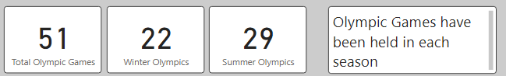
1. How many Olympic Games have been held in each season (Summer vs. Winter)?
Summer Olympics: 29 season held since 1896
Showcases global sportsmanship and competition
Fosters international camaraderie
Winter Olympics: 22 season since 1924
Celebrates cold-weather sports (skiing, skating, snowboarding)
Symbol of excellence in winter sports

Slide 7
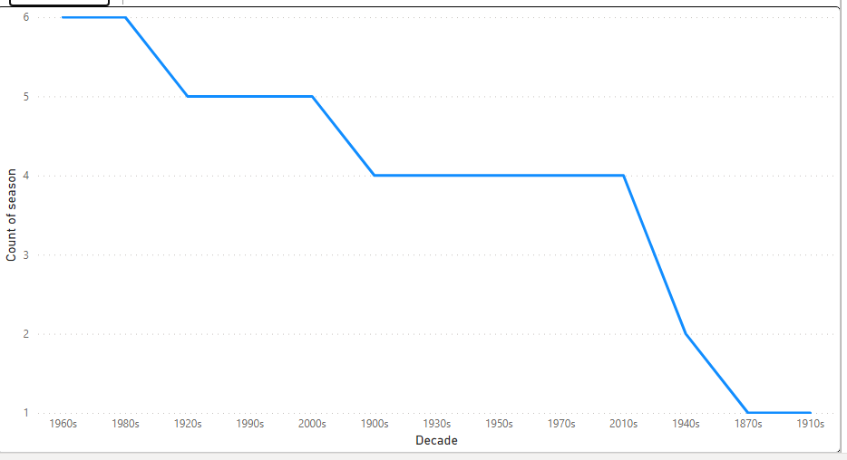
2. What is the distribution of games across different decades?
Decade | Count of Seasons
1960s | 6
1980s | 6
1920s | 5
1990s | 5
2000s | 5
1900s | 4
1930s | 4
1950s | 4
1970s | 4
2010s | 4
1940s | 2
1870s | 1
1910s | 1

Slide 8
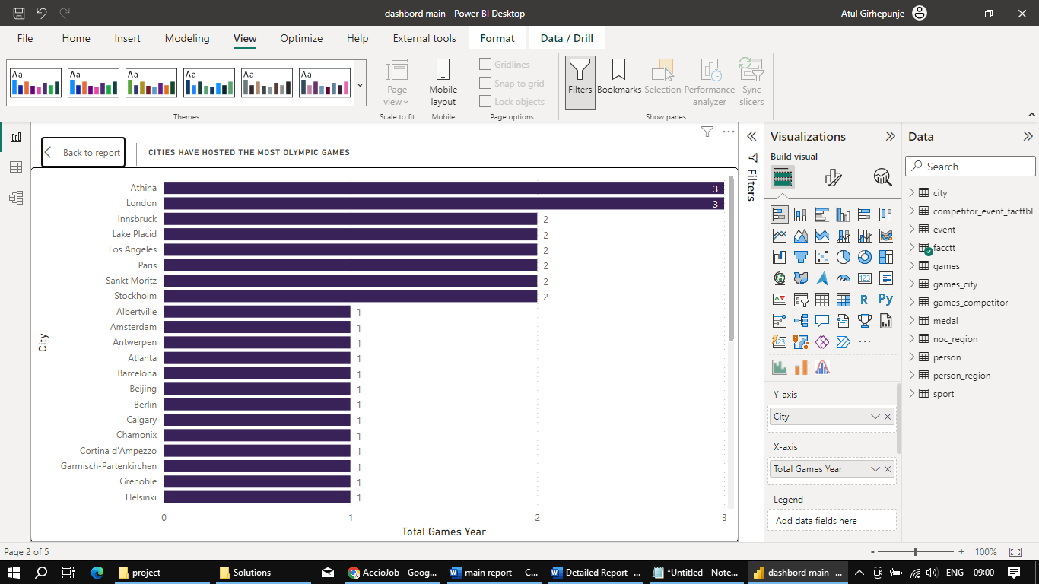
3. Which cities have hosted the most Olympic Games?
Athina and London: Leading the Pack
Summer Olympics Dominance :Athina and London
Winter Olympics Innsbruck, Lake Placid, and Sankt Moritz

Slide 9


4.Sports Distribution in Summer and Winter Olympics
Total Sports: 66 across Summer and Winter Olympics
Summer Olympics: 51 sports showcasing diverse strengths and teamwork
Winter Olympics: 15 sports highlighting expertise in cold-weather challenges

Slide 10
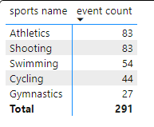
5. Which sports have the highest number of events in the Olympics?
Athletics (83 Events): From sprints to marathons, jumps to throws, Athletics covers a broad spectrum of physical abilities.
Shooting (83 Events): Precision and accuracy are tested across different firearm disciplines, demonstrating mastery under varying conditions.
Swimming (54 Events): Various strokes, distances, and relays showcase the beauty and power of human movement in water.

Slide 11
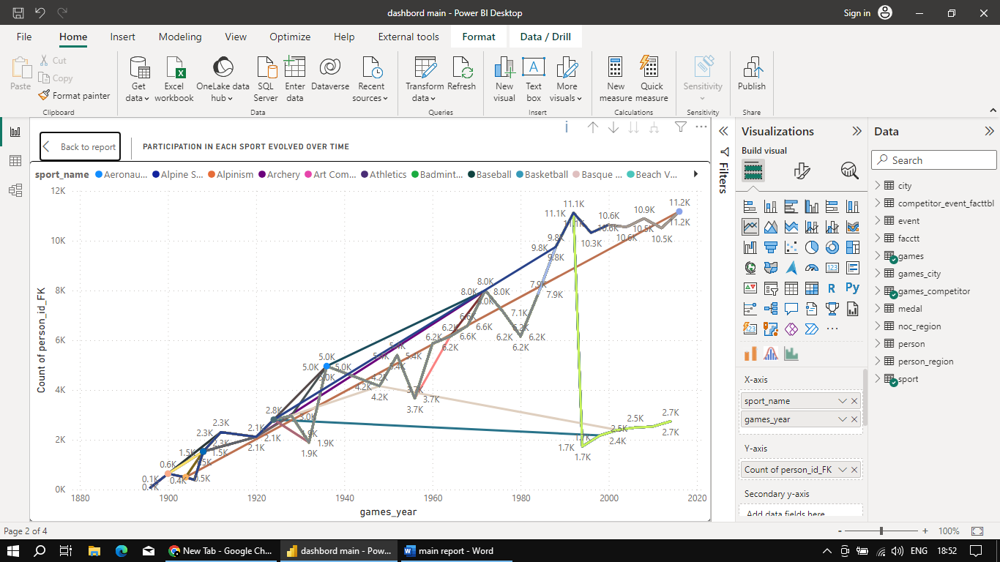
6. How has the participation in each sport evolved over time?
Athletics (Track and Field):
Consistently popular with increasing participation over the years.
Reflects enduring interest and engagement in the sport.
Swimming:
Steady participation and popularity throughout various Olympic editions.
Highlights the universal appeal of aquatic competition.
Gymnastics:
Stable participation, with minor participant fluctuations.
Demonstrates the enduring charm of artistic athleticism.
Basketball:
Sustained upward trend in participation.
Recent editions witness a notable rise in participants.
Cycling:
Varied participation levels with noticeable fluctuations.
Recent years show a general upward trajectory.

Slide 12
7. How many events are there in each sport?
Athletics: 83 Events
Swimming: 54 Events
Gymnastics: 27 Events
Cycling: 44 Events
Rowing: 23 Events
Wrestling: 30 Events
Shooting: 83 Events

Slide 13
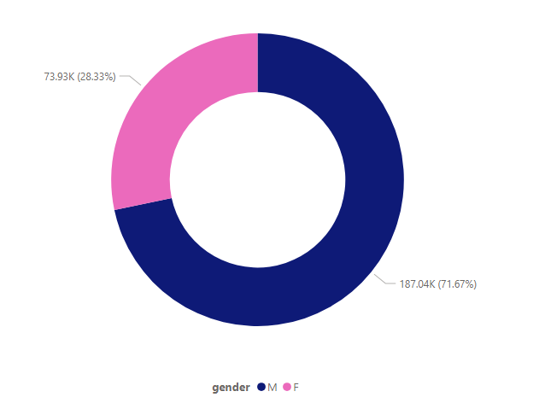
8. What is the distribution of events by gender
Male (M): 187,037 events
Female (F): 73,934 events

Slide 14
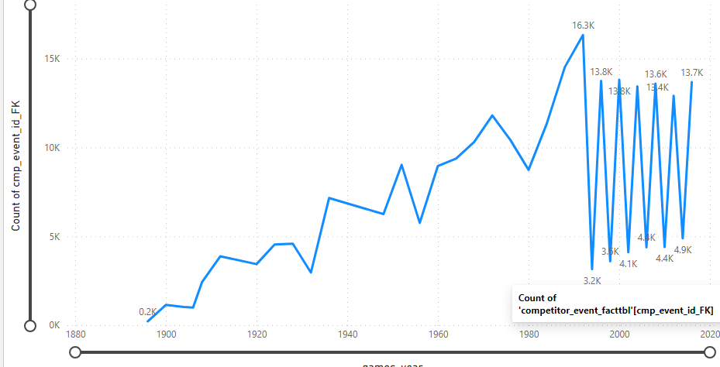
9. How has the number of events changed over time?
Total number of events:
1896: 217 events
2016: 13,685 events
Summer Olympics:
1896: 217 events
2016: 13,685 events
Winter Olympics:
1924: 16 events
2014: 4,888 events

Slide 15
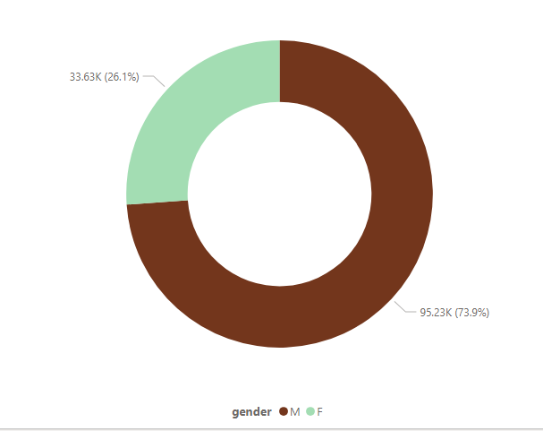
10. What is the distribution of participants by gender?
Male participants (M): 95,225
Female participants (F): 33,629

Slide 16
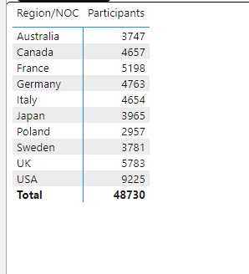
11. Which countries have the highest number of participants in the Olympics?
United States 5,783
United Kingdom 5,198
France 5,198
Germany 4,763
Italy 4,654
Canada 4,657
Australia 3,747
Japan 3,965
Sweden 3,781
Poland 2,957

Slide 17
12. How does the age distribution of participants vary across different games?
Roque, Art Competitions, Alpinism, Polo, and Equestrianism: Average age of 40 or older
Shooting, Motorboating, Curling, and Sailing: Average age of 30s
Athletics, Gymnastics, Swimming, Fencing, Archery, Rowing, and Basketball: Wide range of ages, from 17 to 35.
Rhythmic Gymnastics, Figure Skating, Synchronized Swimming, and Diving.
Ski Jumping, Speed Skating, Snowboarding, and Nordic Combined: Average age of mid-20s
Boxing, Judo, and Taekwondo: Average age of mid-20s to early 30s
Football, Hockey, and Volleyball: Average age of mid-20s to late 20s
Tennis, Badminton, and Weightlifting: Average age of mid-20s
Aeronautics, Basque Pelota, and Military Ski Patrol: Smaller sample size, may have more varied age distributions.

Slide 18
13. How many medals have been awarded in each Olympics?
Year | Total Medals |  | Year | Total Medals
1896 | 102 |  | 1976 | 1542
1900 | 468 |  | 1980 | 1638
1904 | 417 |  | 1984 | 1739
1906 | 310 |  | 1988 | 2246
1908 | 765 |  | 1992 | 2448
1912 | 935 |  | 1994 | 390
1920 | 1175 |  | 1996 | 2001
1924 | 896 |  | 1998 | 492
1928 | 793 |  | 2000 | 2107
1932 | 707 |  | 2002 | 495
1936 | 1011 |  | 2004 | 2064
1948 | 962 |  | 2006 | 541
1952 | 1021 |  | 2008 | 2081
1956 | 1913 |  | 2010 | 520
1960 | 1068 |  | 2012 | 1956
1964 | 1256 |  | 2014 | 608
1968 | 1285 |  | 2016 | 2038
1972 | 1429

Slide 19
14. Which countries have the highest number of gold medals?
Country | Gold Medals
United States (USA) | 2588
Soviet Union | 1203
Germany | 852
United Kingdom (UK) | 666
Italy | 594
France | 499
Sweden | 491
Canada | 466
Russia | 466
Hungary | 464
The United States has won the most gold medals in Olympic history, with a total of 2588. The Soviet Union is in second place with 1203 gold medals, followed by Germany with 852 gold medals. The United Kingdom, Italy, France, Sweden, Canada, Russia, and Hungary round out the top 10 countries with the most gold medals.

Slide 20
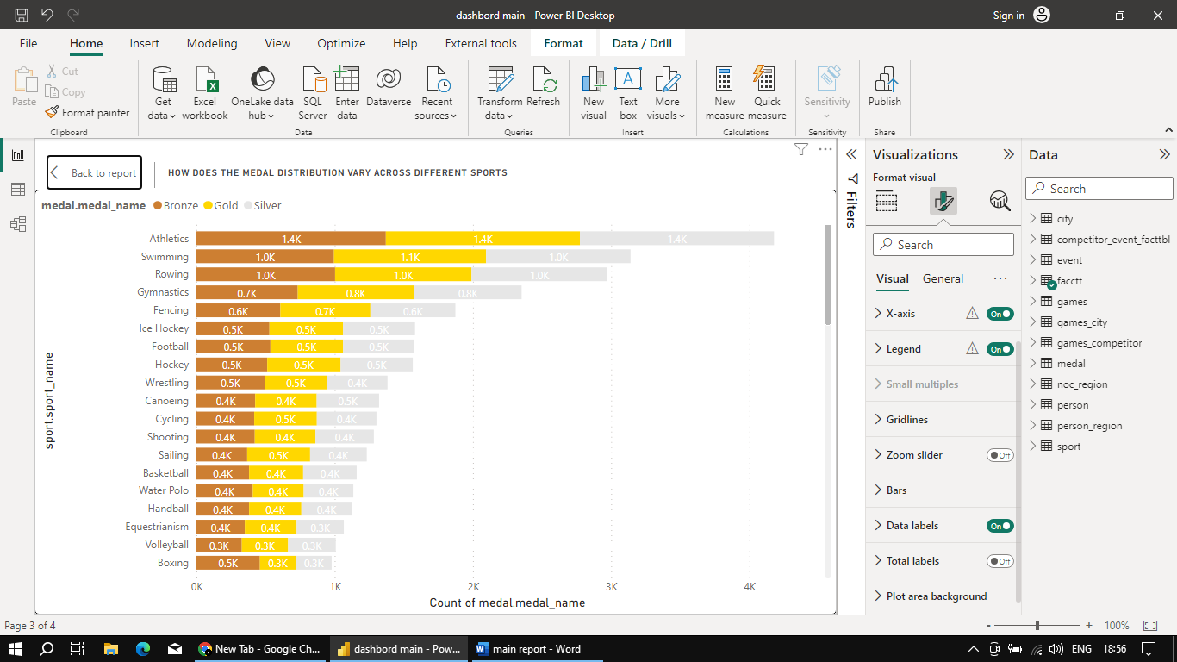
15. How does the medal distribution vary across different sports?
Athletics has seen a balanced distribution of gold, silver, and bronze medals, with 1404 gold medals, 1404 silver medals, and 1370 bronze medals.
Swimming has seen a substantial distribution of medals, with 1100 gold medals, 1045 silver medals, and 995 bronze medals.
Rowing has consistently awarded medals over the years, with 987 gold medals, 981 silver medals, and 1003 bronze medals.

Slide 21
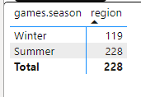
16. How many regions or NOCs participate in each Olympic Games

Slide 22
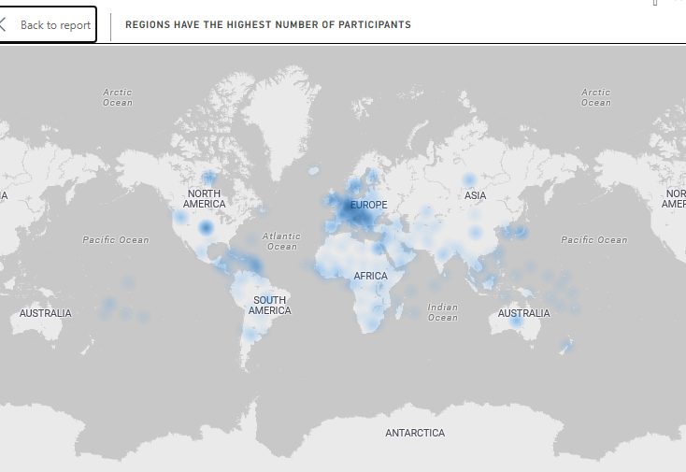
17. Which regions have the highest number of participants in the Olympics?
United States (USA) - 18,551 participants
United Kingdom (UK) - 11,821 participants
France - 11,670 participants
Germany - 10,757 participants
Italy - 10,552 participants

Slide 23
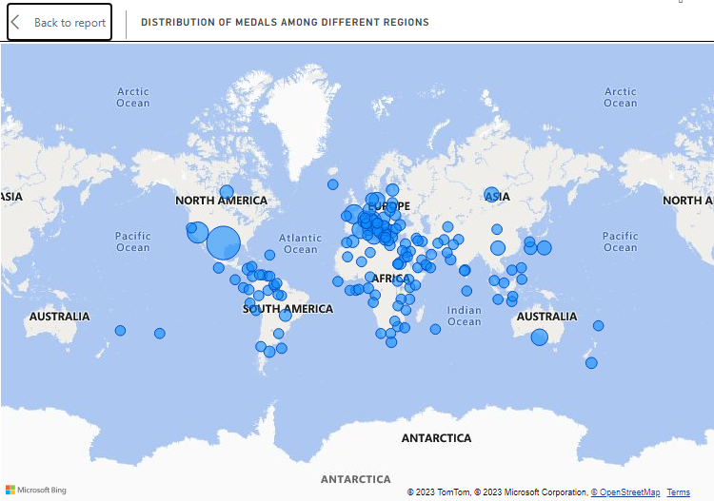
18. What is the distribution of medals among different regions?
Country | Gold | Silver | Bronze | Total
United States | 1,032 | 845 | 771 | 2,648
Soviet Union | 498 | 437 | 417 | 1,352
Germany | 397 | 384 | 383 | 1,164
United Kingdom | 27 | 295 | 284 | 856
France | 247 | 229 | 234 | 710

Slide 24
Conclusion
Dominance of the USA
European Powerhouses
Soviet Union's Legacy
Balance in Medal Distribution
Evolution of Participation

